Slide 1


NLP-Based Fake News Detector
Group 2 Members –
Nayan Gondhali ( Group Leader )
Darshana Hande
Hemant Patil
Girish Jerpoth
Harsheet Baghele
Sangram Dhage
Project Guide -
Ms. Roopa Panicker
Ms. Divya Das
Ms. Soorya M.

Slide 2
Welcome to the presentation on our NLP-Based Fake News Detector. In a world where misinformation is rampant, detecting fake news is crucial for preserving trust and credibility in news sources.
Introduction
Problem Statement
The proliferation of fake news has become a significant concern. We need an effective solution that can automatically identify and flag fake news articles from legitimate ones.

Slide 3
NLP in Fake News Detection
Natural Language Processing (NLP) plays a pivotal role in fake news detection. It enables us to analyze and understand the textual content of news articles, looking for linguistic cues that indicate deception or misinformation.
Data Collection
To train our NLP model, we collect a diverse dataset of news articles, including both real and fake news. This dataset serves as the foundation for our machine learning algorithms.

Slide 4
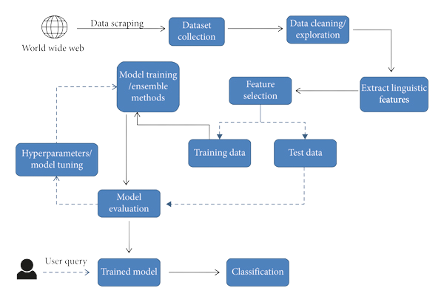
Block Diagram

Slide 5
Libraries Used
Numpy
Pandas
Nltk
Wordcloud
Seaborn
Sklearn
tkinter

Slide 6

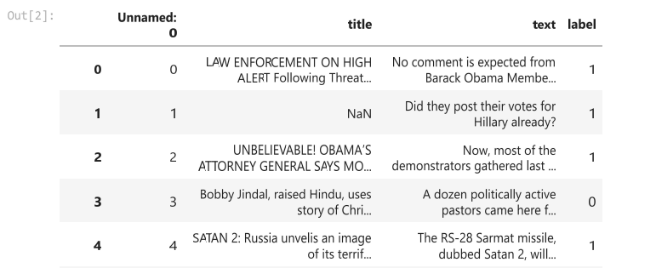
Steps Involved In Model
1. Load the Dataset

Slide 7
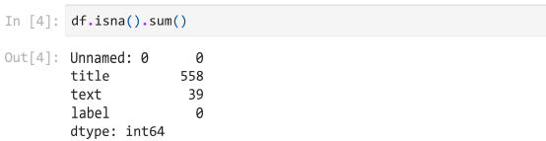
2. Check and drop the Unwanted columns and null values

Slide 8
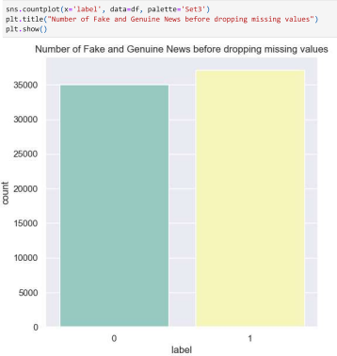
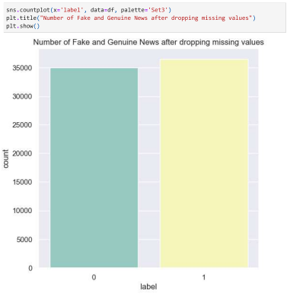
3. Visualizing count of fake and genuine news

Slide 9
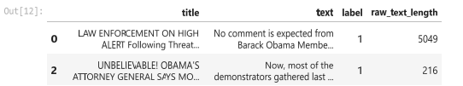
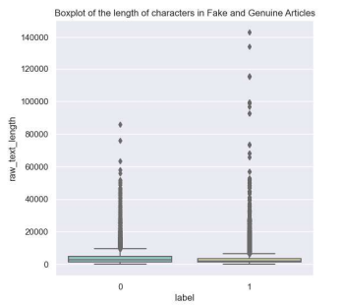
4. Feature Extraction for checking length of text

Slide 10
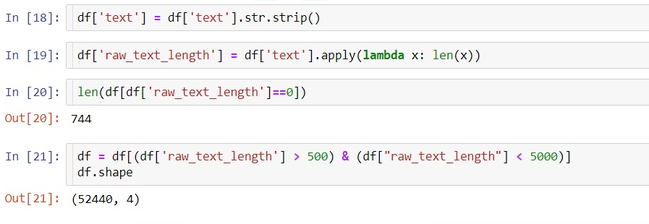
5. Data Cleaning

Slide 11

Data Preprocessing
Before feeding the data into our NLP model, we perform data preprocessing tasks, such as text cleaning, tokenization, and removing stop-words and irrelevant information.

Slide 12
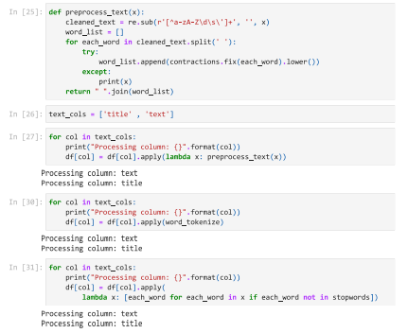
6. Text Cleaning tokenization, and removing stop-words

Slide 13

Feature Extraction for Data Visualization
Feature extraction is a crucial step where we convert text data into numerical features. Techniques like TF-IDF and word embeddings help represent textual information in a format suitable for machine learning.

Slide 14
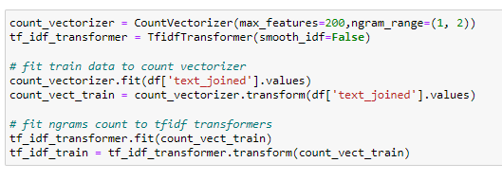
7. Count Vectorizer

Slide 15
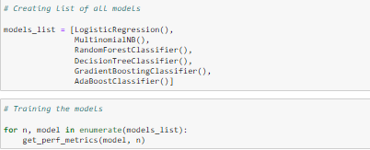
Machine Learning Models
We employ machine learning models to learn patterns in the textual data and classify news articles as real or fake.

Slide 16
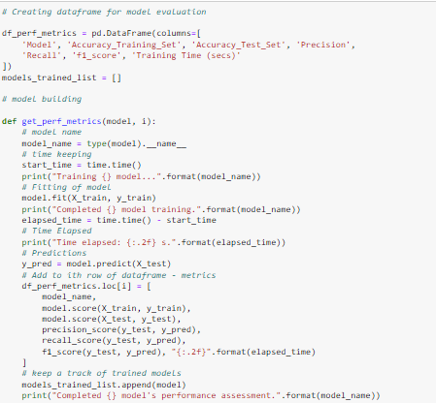

Slide 17
We evaluate our NLP model's performance using metrics such as accuracy, precision, recall, and F1-score. Robust evaluation ensures the reliability of our fake news detection system.
Model Evaluation
Our NLP-based fake news detector demonstrates impressive accuracy, outperforming traditional rule-based approaches. We consistently achieve accuracy rates above 90% in our experiments.

Slide 18
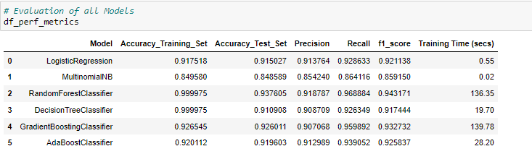
Results and Accuracy Before Hyperparameter Tuning

Slide 19
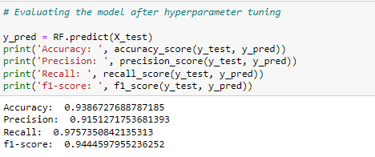
Results and Accuracy After Hyperparameter Tuning

Slide 20
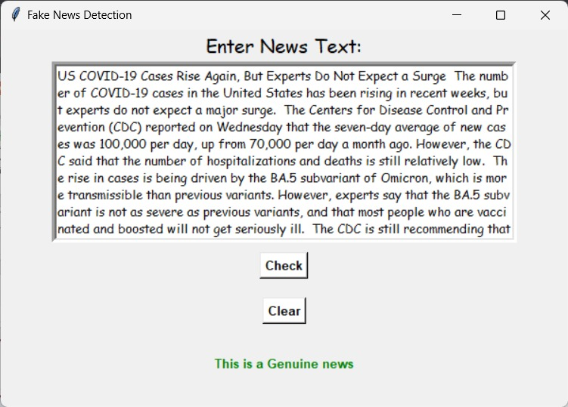
Graphic User Interface

Slide 21
Challenges Faced
Data Quality and Quantity: Developing effective fake news detection models requires a large and diverse dataset of both real and fake news. Gathering such data can be challenging
Continuous Monitoring and Maintenance: Models can drift over time as the data distribution changes. Continuous monitoring and retraining are necessary to maintain model performance.

Slide 22
In conclusion, our NLP-Based Fake News Detector is a powerful tool for automatically identifying and flagging fake news articles. It leverages the capabilities of natural language processing and machine learning to enhance information integrity in the digital age.
Conclusion

Slide 23
References
Shu, K., Mahudeswaran, D., Wang, S., Lee, D., & Liu, H. (2019). Fake News Detection on Social Media: A Data Mining Perspective. ACM Computing Surveys, 52(5), 1-34.
ang, W. Y. (2017). "Liar, Liar Pants on Fire": A New Benchmark Dataset for Fake News Detection. In Proceedings of the 55th Annual Meeting of the Association for Computational Linguistics (Volume 2: Short Papers) (pp. 422-426).

Slide 24

Thank you for your attention!

Slide 25

Questions ?

